Slide 1


SAP S/4HANA Training
MASTER DATA GOVERNANCE (SAP MDG)
Neeraj Gupta
Session- 24
SAP MDG – Use Case in Data Enrichment
Editions

Slide 2
ADDRESS VALIDATION
24
SAP MDG – Data Enrichment – Address Validation
Use Case: Integrate any third-party solution for address validation into MDG
Implement BAdI ADDRESS_CHECK
Create a third party WebDynpro component
Create UI Component for user decision dialogs
Maintain error codes. The appropriate view is V_MDG_SDQ_MSG_UI
Create a feeder class
Create an adapter class for the following scenarios:
1:1 mapping scenario
Addresses with error

Slide 3
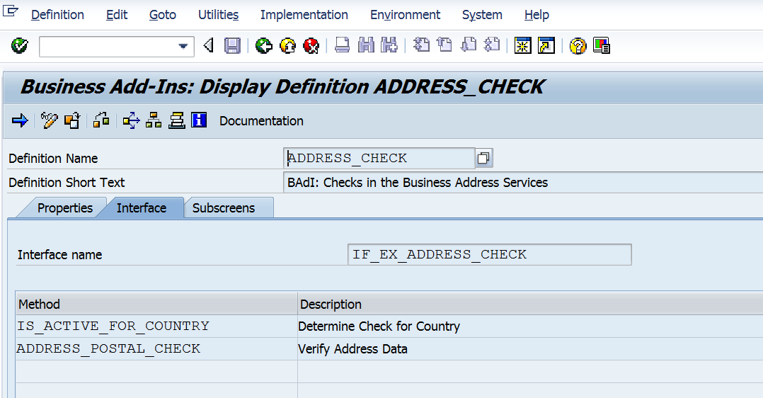
ADDRESS VALIDATION
24
SAP MDG – Data Enrichment – Address Validation
Use Case: Integrate any third-party solution for address validation into MDG
Step 1: Implement BADI ADDRESS_CHECK
Third party service implements the standard BAdI provided for validation:
ADDRESS_CHECK

Slide 4
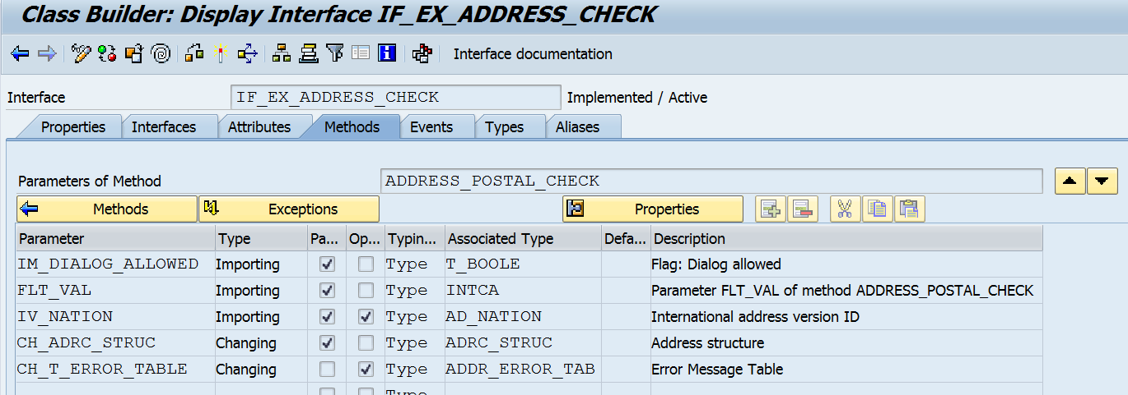
ADDRESS VALIDATION
24
SAP MDG – Data Enrichment – Address Validation
Use Case: Integrate any third-party solution for address validation into MDG
Step 1: Implement BADI ADDRESS_CHECK
Third party service implements the standard BAdI provided for validation:
ADDRESS_CHECK

Slide 5
ADDRESS VALIDATION
24
SAP MDG – Data Enrichment – Address Validation
Use Case: Integrate any third-party solution for address validation into MDG
Step 2: Create Third Party WebDynpro Component
If the address validation-3rd party service does not use ABAP technology, then a corresponding implementation in WebDynpro ABAP needs to be created
Implement the interface: MDG_SDQ_ADDR_CHECK_INTF

Slide 6
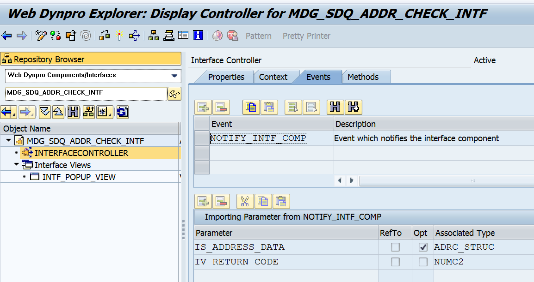
ADDRESS VALIDATION
24
SAP MDG – Data Enrichment – Address Validation
Use Case: Integrate any third-party solution for address validation into MDG
Step 2: Create Third Party WebDynpro Component
Implement the interface: MDG_SDQ_ADDR_CHECK_INTF

Slide 7
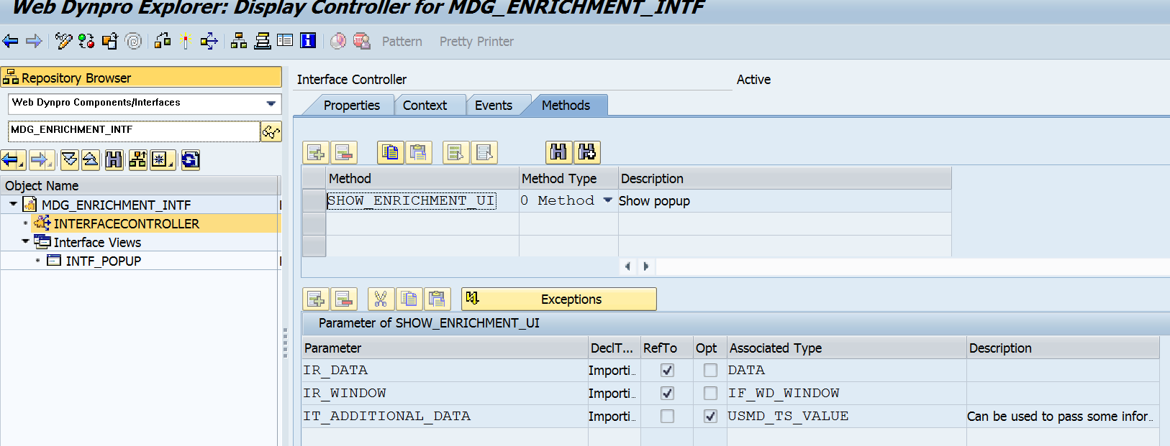
ADDRESS VALIDATION
24
SAP MDG – Data Enrichment – Address Validation
Use Case: Integrate any third-party solution for address validation into MDG
Step 3: Create UI Component for User Decision Dialogs (ZMDG_SDQ_ADDR_ENRICHMENT)
Implement the interface: MDG_ENRICHMENT_INTF

Slide 8
ADDRESS VALIDATION
24
SAP MDG – Data Enrichment – Address Validation
Use Case: Integrate any third-party solution for address validation into MDG
Step 3: Create UI Component for User Decision Dialogs (ZMDG_SDQ_ADDR_ENRICHMENT)
Implement the interface: MDG_ENRICHMENT_INTF
>> In EXECUTE method, UI Component details are maintained
>> get_ui_data fetches the additional details from adapter implementation and then events SHOW_ENRICHMENT_UI and END_USER_INTERACTION are triggered
>> Feeder method prepare_ui_data

Slide 9
ADDRESS VALIDATION
24
SAP MDG – Data Enrichment – Address Validation
Use Case: Integrate any third-party solution for address validation into MDG
Step 4: Maintain Table MDG_SDQ_MSG_UI
(View: V_MDG_SDQ_MSG_UI)
BAdI method address_postal_check returns an error code: MSGNR. And the mapping table provides the POPUP_COMP_NAME and TITLE_OTR_ALIAS as global parameters for additional details

Slide 10
ADDRESS VALIDATION
24
SAP MDG – Data Enrichment – Address Validation
Use Case: Integrate any third-party solution for address validation into MDG
Step 5: Create Feeder Class
(ZCL_USMD_ADDR_ENRICH_FEEDER)
Implement Interface: IF_USMD_ENRICHMENT_FEEDER
Methods:
>> GET_RELEVANT_ENTITIES – E.g AD_POSTAL
>> IF_RELEVANT - Object Type Code (OTC) of the business object in the CR
>> GET_ADAPTER_DATA - Retrieves the data in adapter format for enrichment
>> GET_MDG_DATA - Convert the data from adapter format to MDG format
>> FETCH_ADAPTER_DATA
>> FETCH_MDG_DATA
>> PREPARE_UI_DATA
>> CONVERT_ACTION_RESULT - MDG format to adapter format for further processing by the adapter

Slide 11
ADDRESS VALIDATION
24
SAP MDG – Data Enrichment – Address Validation
Use Case: Integrate any third-party solution for address validation into MDG
Step 5: Create Feeder Class
(ZCL_USMD_ADDR_ENRICH_FEEDER)
Example: User Interaction is required for executing an enrichment
A corresponding UI presents the user with a list of values (in MDG format). The user chooses a row from the list and chooses OK. This value needs to be returned to the adapter for processing. Before passing the data chosen on the UI to the
adapter, the CONVERT_ACTION_RESULT method converts the data from MDG format to adapter format.

Slide 12
ADDRESS VALIDATION
24
SAP MDG – Data Enrichment – Address Validation
Use Case: Integrate any third-party solution for address validation into MDG
Step 6: Create Adapter Class
(ZCL_USMD_ADDR_ENRICH_FEEDER)
Interface - IF_USMD_ENRICHMENT_ADAPTER
Method EXECUTE - Call to the external or internal service to get the enriched data
>> In case user interaction is required, the flag EF_USER_ACTION_NECESSARY is set along with sending the data (ER_DATA) necessary to be displayed on the UI
Mapping Scenario
>> For addresses with slight error, the popup is suppressed, no error code is sent and the
address is immediately corrected without any user intervention.
>> For addresses that require user-intervention for validation, the initial popup to be displayed is being determined in this method by using the error-code sent by the check_postal_address method and subsequently pick up the additional details from the table MDG_SDQ_MSG_UI based on the error code sent.

Slide 13
Editions
24
SAP MDG – Edition
Edition Based Process Flow
Edition Type – It identifies the Data Model and Entity Types that can be processed in an Edition

Slide 14
OG_ALL Edition Type
24
SAP MDG – Process Modelling

Slide 15
Entity type in the OG_ALL Edition Type
24
SAP MDG – Process Modelling

Slide 16
Edition creation
24
SAP MDG – Edition

Slide 17
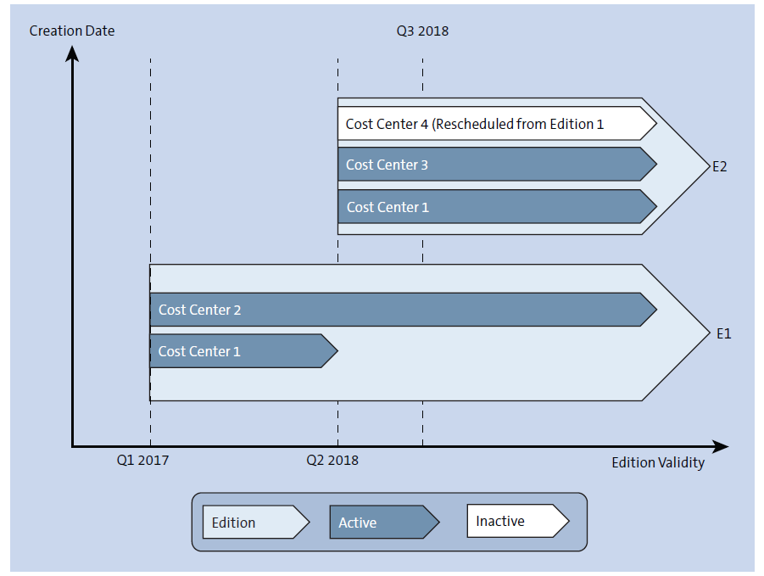
Flexibility of Edition
24
SAP MDG – Edition

Slide 18
Edition Release
24
SAP MDG – Edition

Slide 19
Edition Analysis
24
SAP MDG – Edition

Slide 20
Edition Comparison
24
SAP MDG – Edition

Slide 21

End of Session24

Slide 22

Questions

Slide 23

Neeraj gupta

Slide 24


We’re committed to empower you to be
Most Desirable Resource
through powerful training solutions.
We build the workforce of the future.
250+
Corporate Clients
30,000+
Learners Trained
25000+
Learners Placed
FREE WEBINARS
Sign up for free webinars with industry experts every fortnight!
Enroll Now!
Contact us today!
https://anubhavtrainings.com/

Slide 25




More from AnubhavTrainings.com

